Slide 1


Factors Driving House Prices.
Research

Slide 2
Data Information(main variables considered)
- Sales Prices
- year of sale
- Heating Quality
- Overall Condition
- Central Air Conditioning

Slide 3
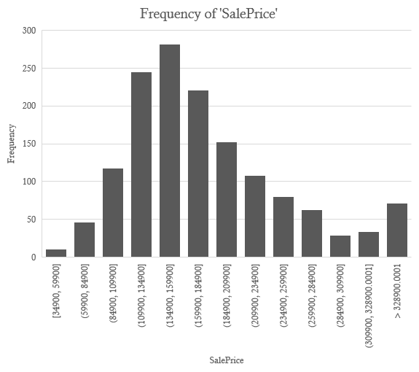
Sale prices

Slide 4
Year Of Sale Vs Sale Prices.

Slide 5
Total Sales Prices by Heating Quality.

Slide 6
Overall condition rating By sales Price

Slide 7
Central Air Conditions
Ho: μ1 - μ2 = 0 Ha: μ1 - μ2 ≠ 0
Null hypothesis being that theres no effect on prices between houses that have Central air conditioning and those that don’t.
t-Test: Two-Sample Assuming Unequal Variances
 | Central Air(Y) | Central Air(N) |  |  | Central Air(Y) | Central Air(N)
Mean | 207359.6815 | 106173.9136 |  | Mean | 207359.6815 | 106173.9136
Variance | 9646265067 | 1769491729 |  | Variance | 9646265067 | 1769491729
Observations | 631 | 81 |  | Observations | 631 | 81
Hypothesized Mean Difference | 0 |  |  | Standard error | 3909.893394 | 4673.925213
df | 218 |  |  | c.i. upper | 7706.030789 | 9211.865382
t Stat | 16.60505543 |  |  | c.i. lower | 7706.030789 | 9211.865382
P(T<=t) one-tail | 7.20685E-41
t Critical one-tail | 1.651873373
P(T<=t) two-tail | 1.44137E-40
t Critical two-tail | 1.970905601
Total sample size | 712
mean difference | 101185.7679
standard error of difference | 6093.672394
confidence interval( standard error of difference* critical value) | 12010.05305
Lower Limit | -89175.71482
Upper Limit | 113195.8209
s pooled | 18.86796226
cohen's d | 5362.834972
with a p value of 1.44 we fail to reject the null hypothesis.
Therefore there is a difference between house prices for the houses that have central Air conditioning
and those that do not have central Air conditioning and therefore this is a factor that should be considered as one that drives house prices.

Slide 8
Chart showing central air conditions Vs sales Price.

Slide 9


Recommendations
There are many variables that drive home prices. The key variables shown in this presentation appear to drive home prices a lot more and at a more measurable pace and would be more suited to be determining factors when considering the variance of home prices.

